Slide 1



Fake Profile Detection
Team Member 1 : Atharva Desai - 16010121042
Team Member 2 : Dhruv Gundecha - 16010121062
Team Member 3 : Girik Bhambra - 16010121014
Faculty Advisor : Dr. Bhakti Palkar

Slide 2
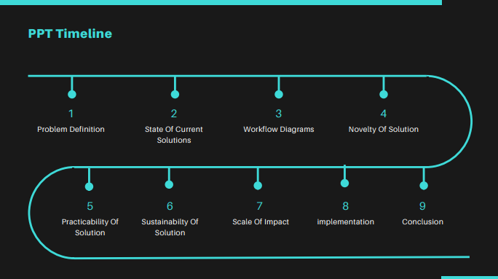

Slide 3
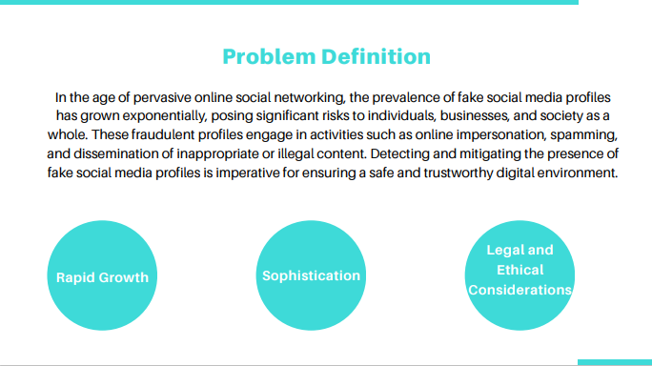

Slide 4
Research Paper | Author(s) | Methodology | Pros | Cons | Observations and Findings
Survey on Social Media Deception Detection Techniques | A. Kumar, A. Das, S. Saha, et al. | Review and analysis of deception detection techniques, including ML, NLP, and behavioral analysis | Comprehensive overview, Identification of trends and commonalities across different approaches | May lack in-depth analysis of individual techniques | Provides a broad understanding of various deception detection methods but might not delve deeply into specific techniques.
Fake Profile Detection Using Machine Learning | B. Wang, N. Zhang, X. Cao, et al. | Application of ML algorithms for feature extraction and classification | Focus on algorithmic aspects, Evaluation of classifier performance and feature relevance | Limited exploration of non-ML methods | Concentrates on ML techniques for fake profile detection but may overlook other potential approaches.
Analysis of Social Network Characteristics for Fake Accounts | M. Yang, R. Cai, X. Li, et al. | Analysis of network-based features associated with fake accounts | Insights into social network characteristics relevant to detection, Identification of distinctive patterns in social network structures | May not cover behavioral or content-based features in-depth | Provides insights into social network structures relevant for detecting fake accounts but may not consider all aspects like user behavior or content analysis.
Behavioral Analysis for Fake Account Identification | S. Park, Y. Choi, H. Kim, et al. | Investigation of behavioral patterns in social networks | Emphasis on understanding anomalies in user behavior, Discovery of behavioral indicators of fake accounts | Potential limitations in addressing content-based features | Focuses on behavioral patterns but might overlook content-based features which could be crucial for detection.
Deep Learning Approaches for Fake Profile Detection | N. Gaur, V. Kumar, S. Khan, et al. | Application of deep learning techniques for feature extraction and classification | Exploration of advanced neural network models, Evaluation of deep learning effectiveness in fake profile detection | Computational complexity and potential data requirements | Focuses on deep learning methods, which might require significant computational resources and data, limiting practicality in some scenarios.
Privacy-Preserving Fake Account Detection | C. Zhang, J. Zhang, X. Zhang, et al. | Development of techniques preserving user privacy in detection | Ethical considerations and compliance with data protection, Identification of privacy-preserving mechanisms for detection | Potential trade-offs between privacy and detection accuracy | Addresses the crucial issue of privacy preservation but might face challenges in maintaining high detection accuracy while preserving privacy.
Real-time Fake Account Detection using Social Graph Analysis | A. Gupta, S. Kumar, A. Mittal, et al. | Real-time detection leveraging social graph analysis | Timely identification of fake accounts, Exploration of social graph dynamics in real-time detection | Challenges in scalability for real-time processing | Focuses on real-time detection, but scalability issues may arise, especially with the complexity of social graph analysis in real-time scenarios.
Challenges in Fake Profile Detection on Cross-Platform Social Networks | R. Sharma, S. Jain | Identification and analysis of challenges in cross-platform detection | Recognition of issues in extending detection across multiple platforms, Highlighting challenges and proposing potential solutions | May require specific considerations for each platform | Acknowledges the complexities of cross-platform detection, suggesting that a one-size-fits-all approach may not be feasible, requiring platform-specific strategies.

Slide 5
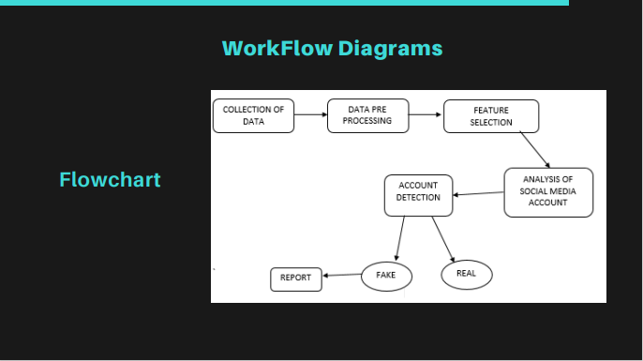

Slide 6
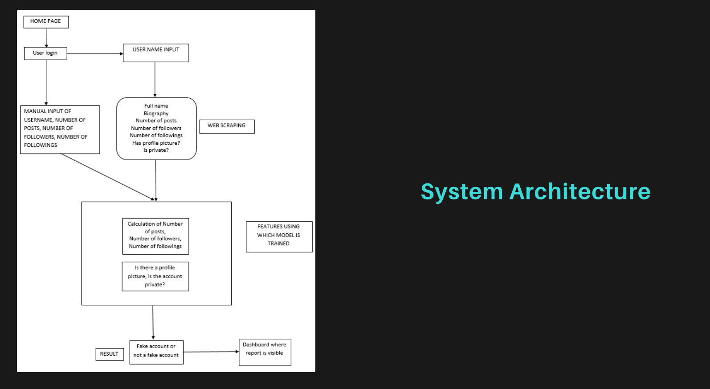

Slide 7
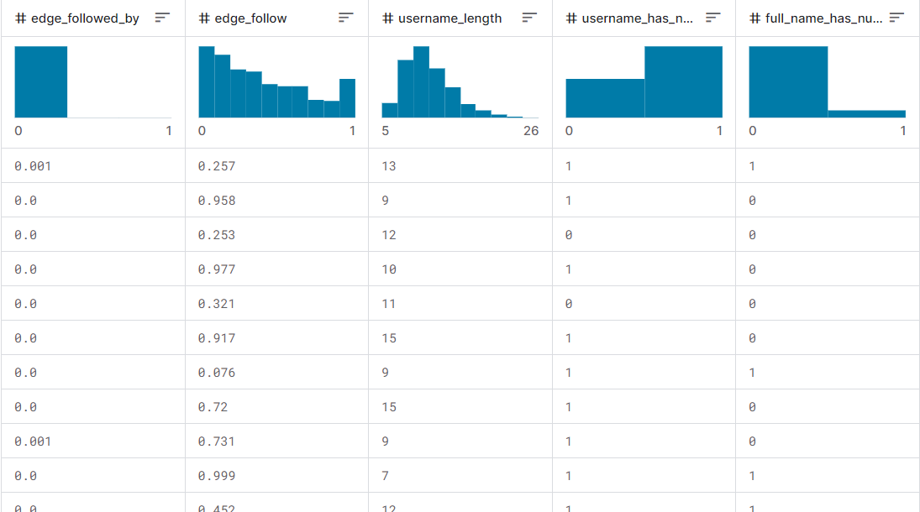
Dataset and Data Dictionary
Link : https://www.kaggle.com/datasets/rezaunderfit/instagram-fake-and-real-accounts-dataset

Slide 8
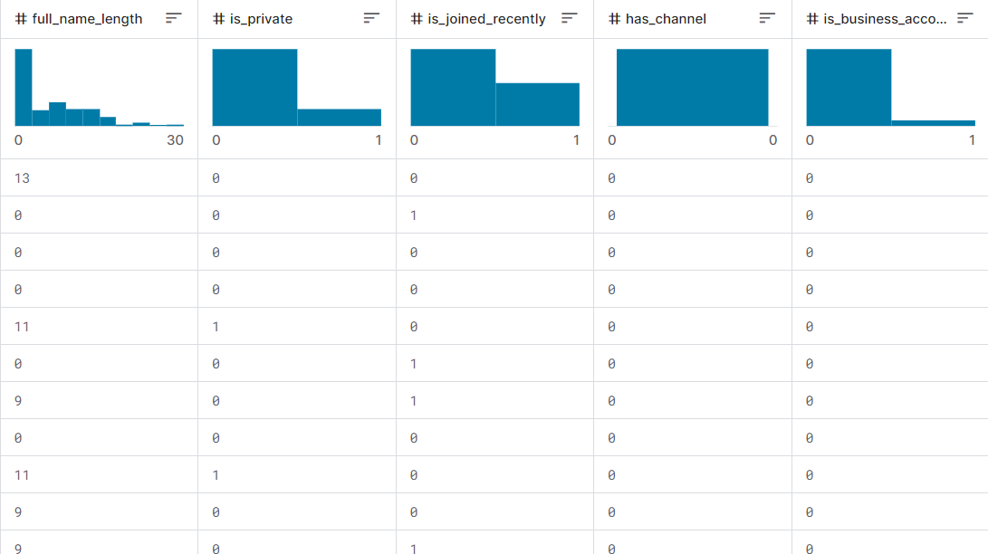
Dataset and Data Dictionary
Link : https://www.kaggle.com/datasets/rezaunderfit/instagram-fake-and-real-accounts-dataset

Slide 9
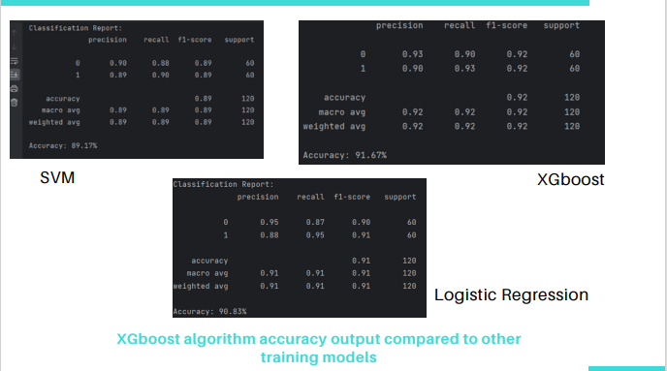

Slide 10
Hardware And Software Requirements
HARDWARE REQUIREMENTS
Processor - I3 Above
Speed - 2.4 Ghz
RAM - 4 Gb (min)
Hard Disk - 500 Gb
SOFTWARE REQUIREMENTS
Operating System : Windows
Front End : HTML, CSS, JavaScript
Database : SQLAlchemy (Flask)
Language : Python, HTML, JS
APIs : Instaloader

Slide 11
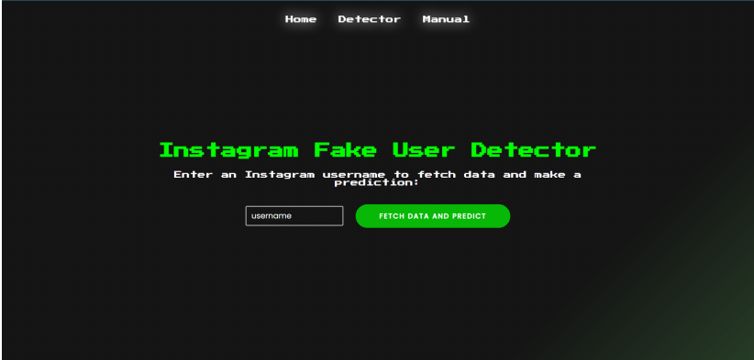
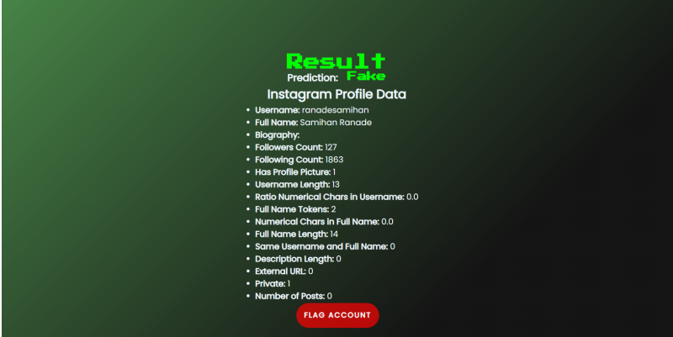
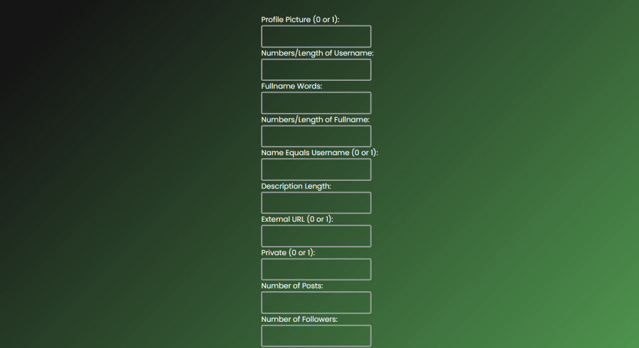
Implementation Screenshots :

Slide 12
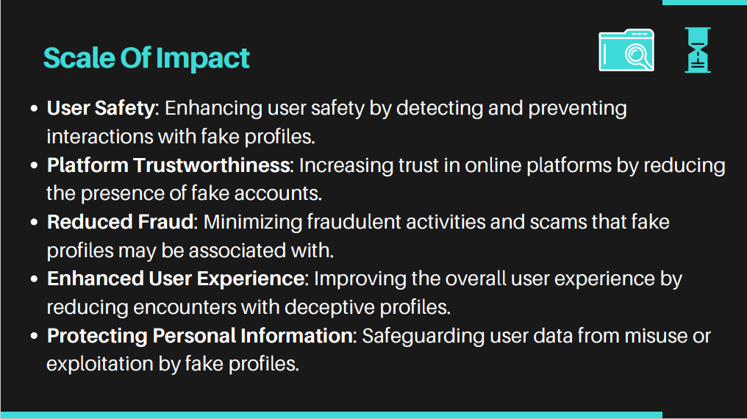

Slide 13
